Slide 1

TREE DATA STRUCTURES
Introduction about the tree’s topic…

Slide 2
Tree Data Structure
Tree is a non-linear data structure which organizes data in a hierarchical structure and this is a recursive definition…
OR
A tree is a connected graph without any circuits…
OR
If in a graph, there is one and only one path between every pair of vertices, then graph is called as a tree…

Slide 3
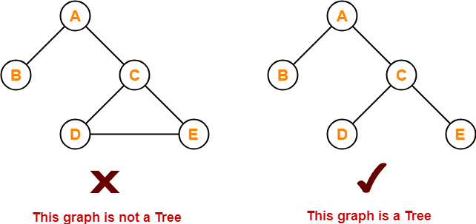
Properties

Slide 4
The important properties of tree data structure are
There is one and only one path between every pair of vertices in a tree.
A tree with n vertices has exactly (n-1) edges.
A graph is a tree if and only if it is minimally connected.
Any connected graph with n vertices and (n-1) edges is a tree.

Slide 5
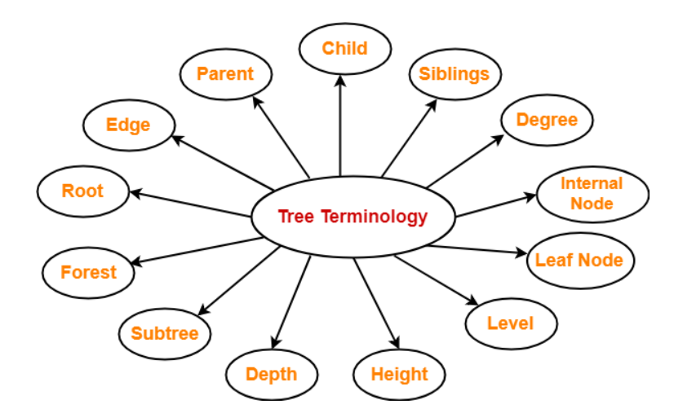
Tree Terminology

Slide 6
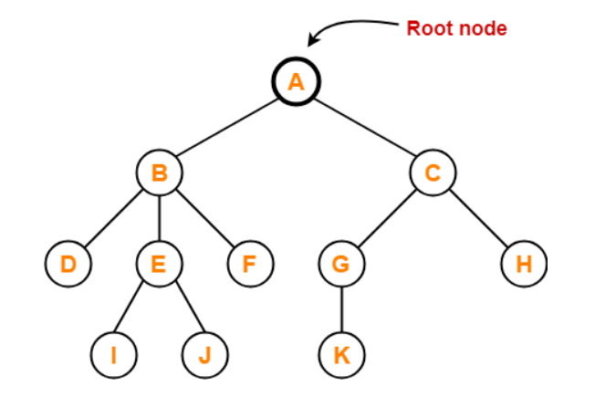
Root
1. The first node from where the tree originates is called a Root Node...
2. In any tree, there must be only one root node...
3. We can never have multiple root nodes in a tree data structure...

Slide 7
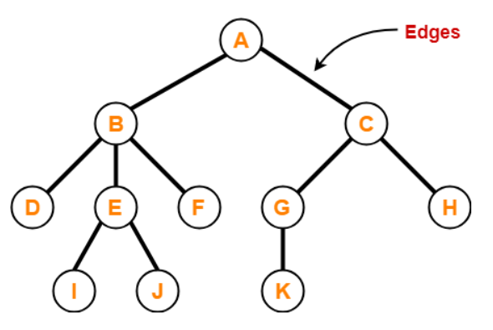
Edge
1. The connecting link between any two nodes is called as an Edge...
2. In a tree with n number of nodes, there are exactly (n-1) number of edges...

Slide 8
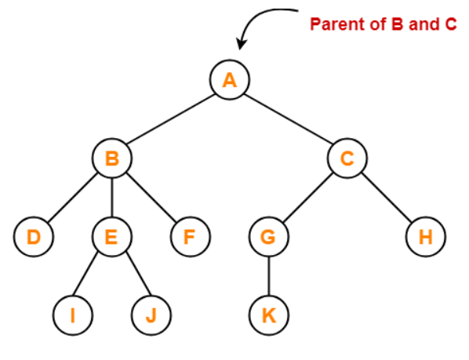
Parent
1. The node which has a branch from it to any other node is called as a Parent Node...
2. In other words, the node which has one or more children is called as a parent node...
3. In a tree, a parent node can have any number of child nodes...

Slide 9
Here..,
Node A is the parent of nodes B and C
Node B is the parent of nodes D, E and F
Node C is the parent of nodes G and H
Node E is the parent of nodes I and J
Node G is the parent of node K

Slide 10
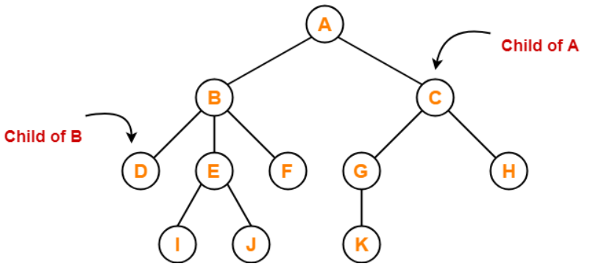
Child
1. The node which is a descendant of some node is called as a Child Node...
2. All the nodes expect root node are child nodes...

Slide 11
Here..,
Nodes B and C are the children of node A
Nodes D, E and F are the children of node B
Nodes G and H are the children of node C
Nodes I and J are the children of node E
Node K is the child of node G

Slide 12
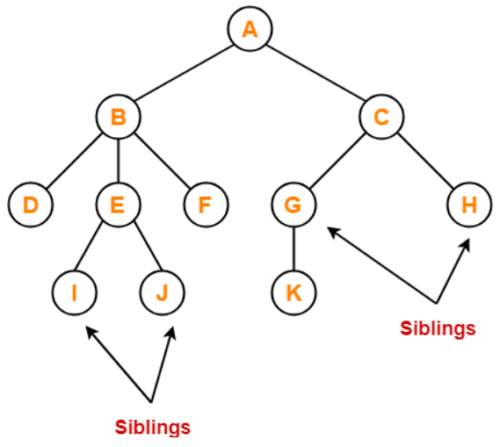
Siblings
1. Nodes which belong to the same parent are called as Siblings...
2. In other words, nodes with the same parent are sibling nodes...

Slide 13
Here..,
Nodes B and C are siblings
Nodes D, E and F are siblings
Nodes G and H are siblings
Nodes I and J are siblings

Slide 14
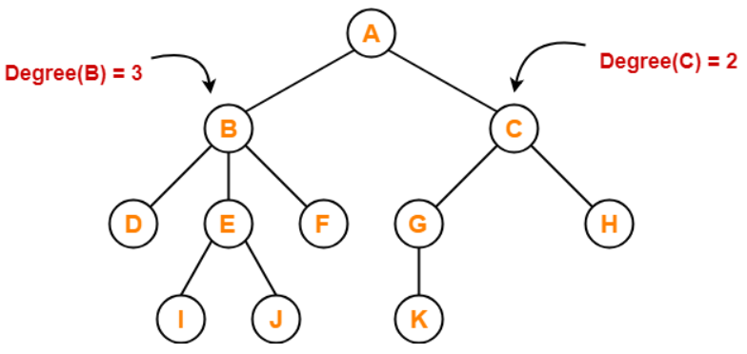
Degree
1. Degree of a node is the total number of children of that node...
2. Degree of a tree is the highest degree of a node among all the nodes in the tree...

Slide 15
Here..,
Degree of node A = 2
Degree of node B = 3
Degree of node C = 2
Degree of node D = 0
Degree of node E = 2
Degree of node F = 0
Degree of node G = 1
Degree of node H = 0
Degree of node I = 0
Degree of node J = 0
Degree of node K = 0

Slide 16
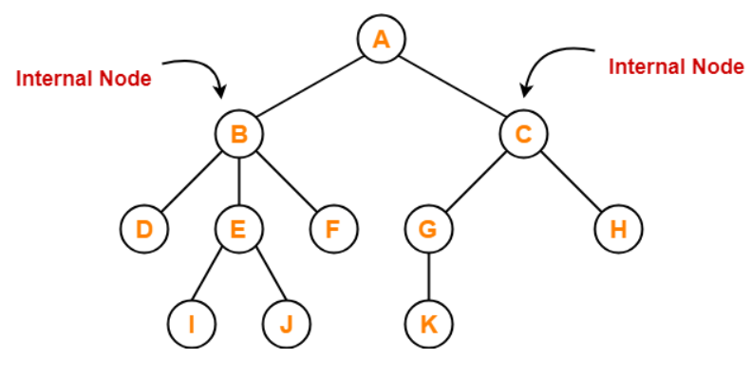
Internal Node
1. The node which has at least one child as an Internal Node...
2. Internal nodes are also called as non-terminal nodes...
3. Every non-leaf node is an internal node...

Slide 17
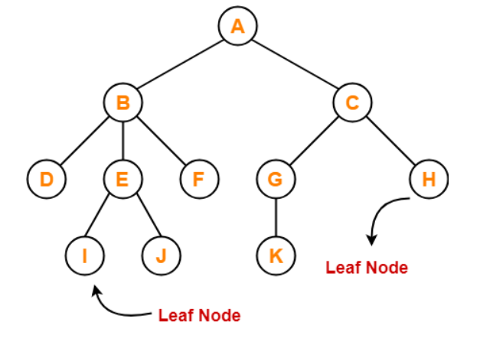
Leaf Node
1. The node which does not have any child is called as a leaf node...
2. Leaf nodes are also called as External nodes or Terminal nodes...

Slide 18
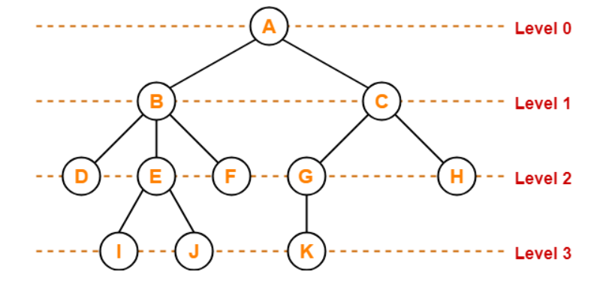
Level
1. In a tree, each step from top to bottom is called as level of a tree...
2. The level count starts with 0 and increment's by 1 at each level or step…

Slide 19
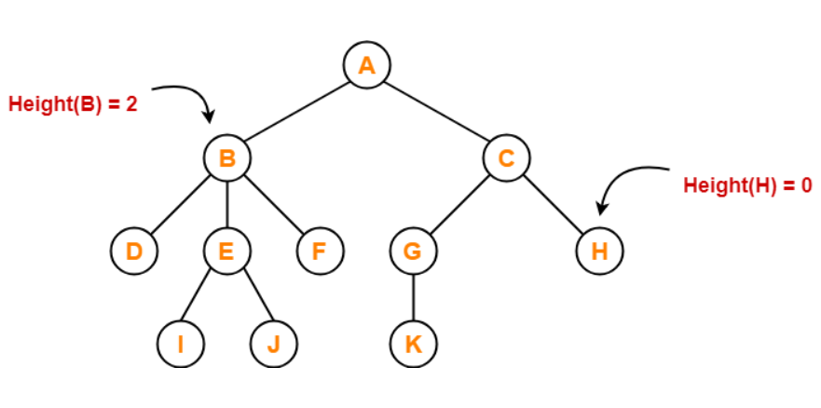
Height
1. Total number of edges that lies on the longest path from any leaf node to a particular node is called as Height of that node...
2. Height of a tree is the height of root node...
3. Height of all leaf nodes=0...

Slide 20
Here..,
Height of node A = 3
Height of node B = 2
Height of node C = 2
Height of node D = 0
Height of node E = 1
Height of node F = 0
Height of node G = 1
Height of node H = 0
Height of node I = 0
Height of node J = 0
Height of node K = 0

Slide 21
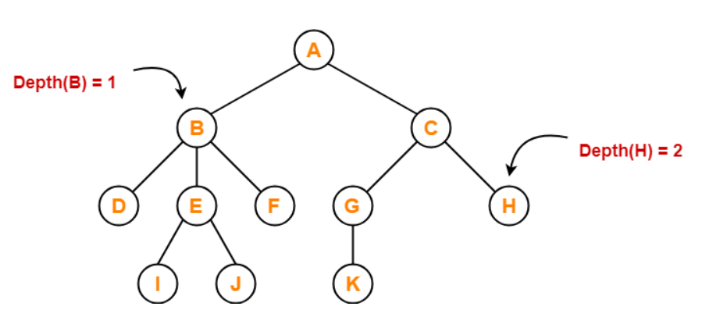
Depth
1. Total number of edges from root to a particular node is called as depth of that node...
2. Depth of a tree is the total number of edges from node to a leaf node in the longest path...
3. Depth of the root node=0...
4. The terms "Level" and "Depth" are used interchangeably...

Slide 22
Here..,
Depth of node A = 0
Depth of node B = 1
Depth of node C = 1
Depth of node D = 2
Depth of node E = 2
Depth of node F = 2
Depth of node G = 2
Depth of node H = 2
Depth of node I = 3
Depth of node J = 3
Depth of node K = 3

Slide 23
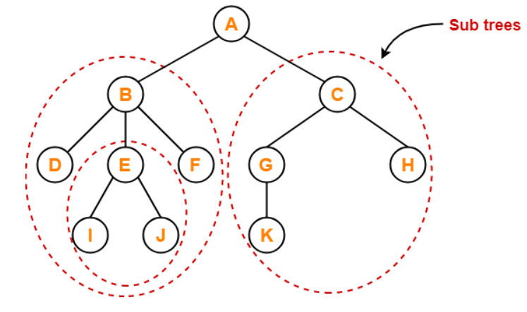
Sub Tree
1. In a tree, each child from a node forms a subtree recursively...
2. Every child node forms a subtree on its parent node...

Slide 24
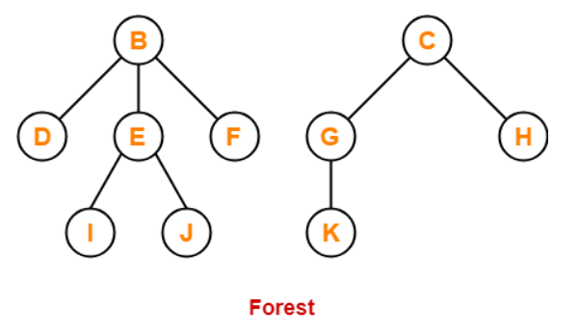
Forest
1. A forest is a set of disjoint trees...

